Slide 1
CMP3103M Autonomous Mobile Robotics
Alexander Bierton
BIE12441314

Slide 2
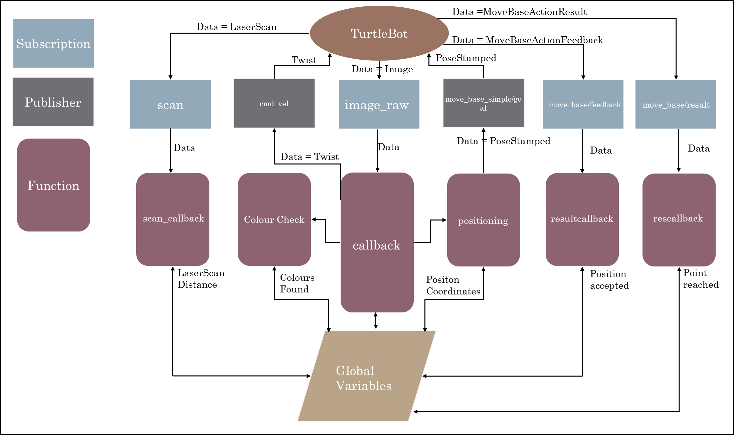
System Design
This system employs global variables (Booleans, arrays, lists and integers)
“move_base_system/goal” has majority control over where the robot goes.
Helped avoid obstacles
The “move_base/feedback” and “move_base/result” update the robots goal progress

Slide 3
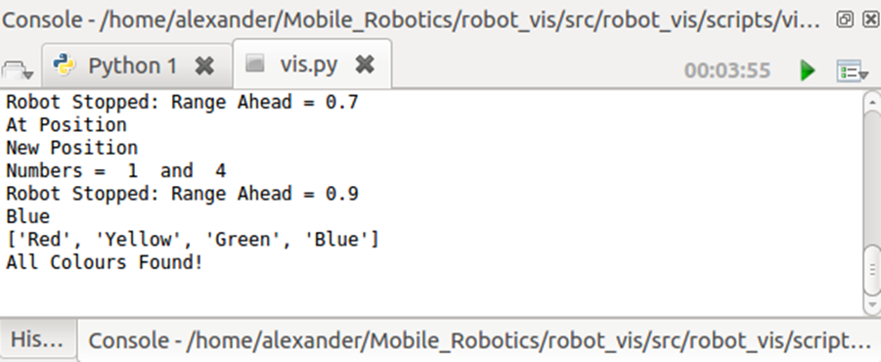
Results and Reflection
The robot stopped at 1 metre distances from each coloured object
The robot came to stop and shutdown the system if all colours had been reached (fig 2).
The System was tested 10 times – 8 of which passed
The completion time of each test were as follows : 4.04, 3.59, 4.40, 4.26, 4.10, 4.20, 4.12, and 3.55
Mean time: 4.03 (SD = 0.29)
% of time used : 80.6%
This shows that there is some area for improvement in the system that could effectively reduce the time consumption down to 75% or under.
There are numerous ways in which time performance could be improved for example:
Custom mapping for the robot – A* or Dijkstras Algorithm could be used for fully autonomous results
Faster rotation while at position – This could decrease the time taken by the robot to search in a spot for an coloured objects that might be nearby.
A better mask view limit – Lowered mask view to help stop collisions was implemented but restricts view distance
Figure 2 – Test Result

